Slide 1
e-Desk
All your solutions in one platform

Slide 2
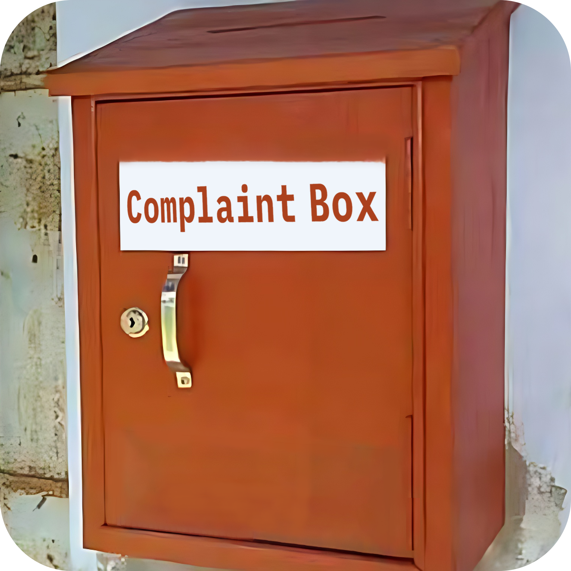
Current Problems
Complexities of Complaints,
Suggestions and Applications
Lack of Transparency and Accountability
Uncertainty in keeping records
Documentation of processes on paper

Slide 3
At A Glance
8
38
22
20-30
Departments
Offices
Faculties
and Institutes
Clubs
and Societies
Source: www.jnu.ac.bd

Slide 4
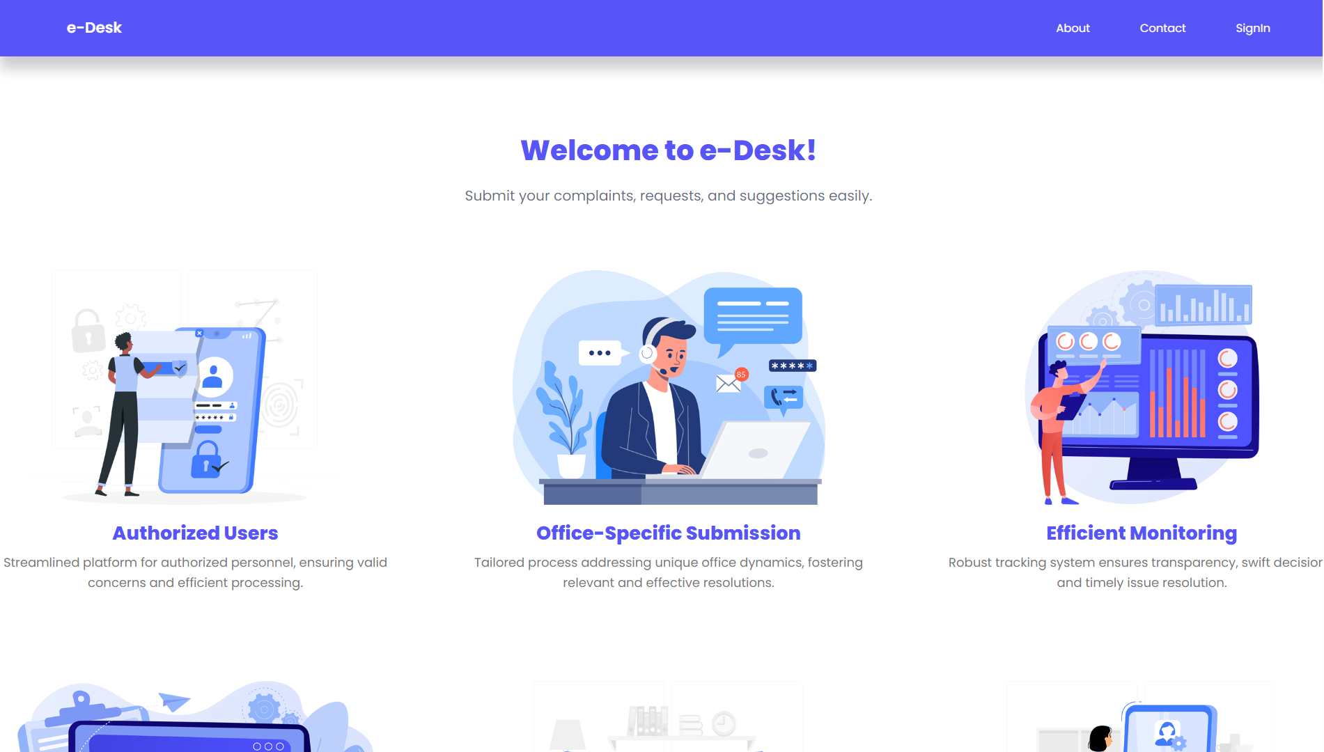
Our Solution
Grievances submission for authorized users
Office-specific grievance submission
Efficient monitoring and decision-making
Digital records for each submission
Immediate authority responses

Slide 5
System Overview
add and manage offices
approve and manage users
Admin can
approve and manage posts
monitor the Complaints, Suggestions, Applications and take necessary steps
e-Desk
comment on the posts
submit Complaints
User can
give Suggestions
submit Applications
see the current status of Grievances

Slide 6
e-Desk Home Page

Slide 7
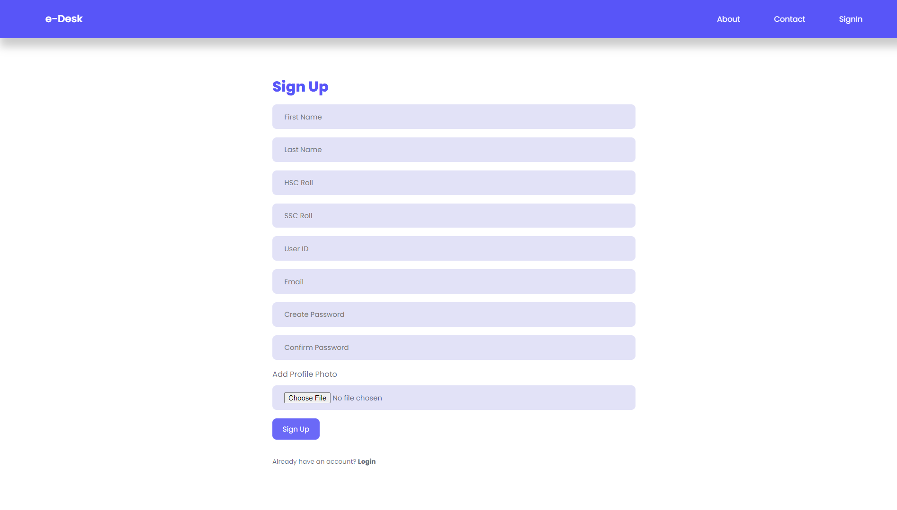
User Registration

Slide 8
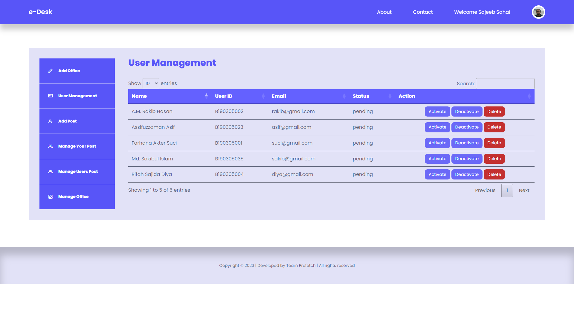
Admin Approval

Slide 9
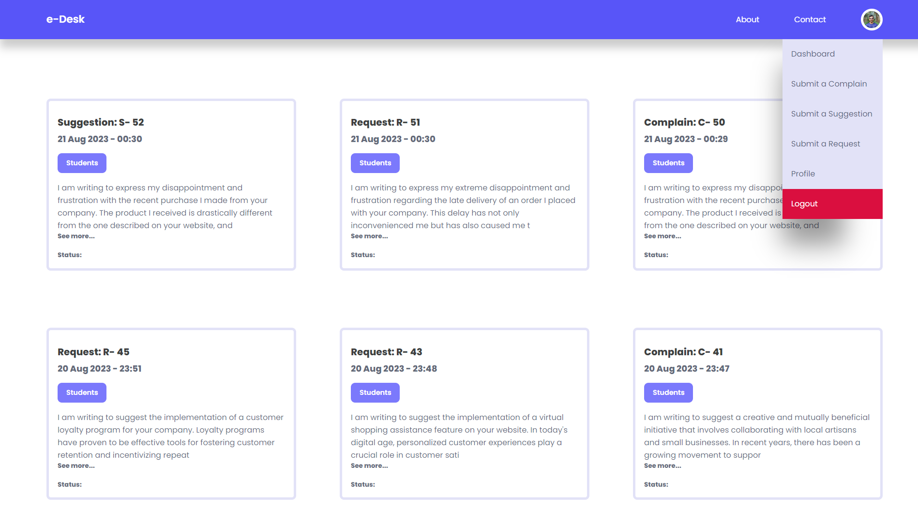
User Home Page

Slide 10
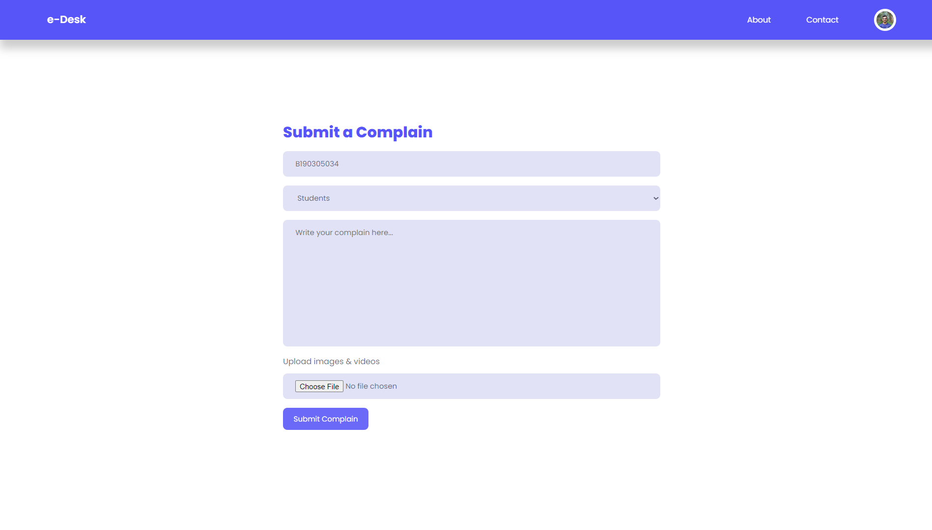
User – Submit a Complain

Slide 11
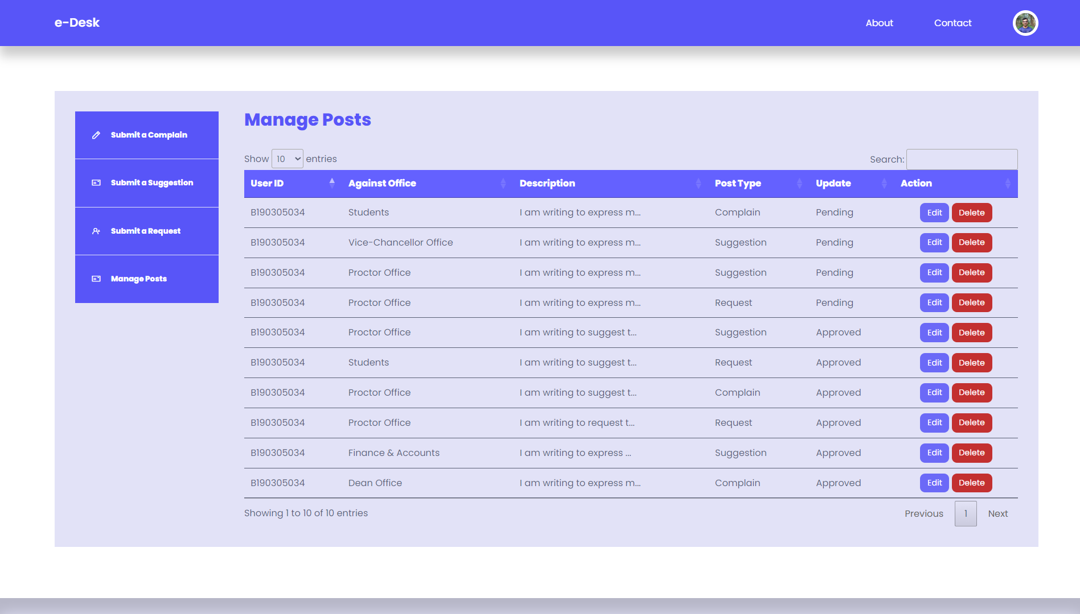
User Dashboard

Slide 12
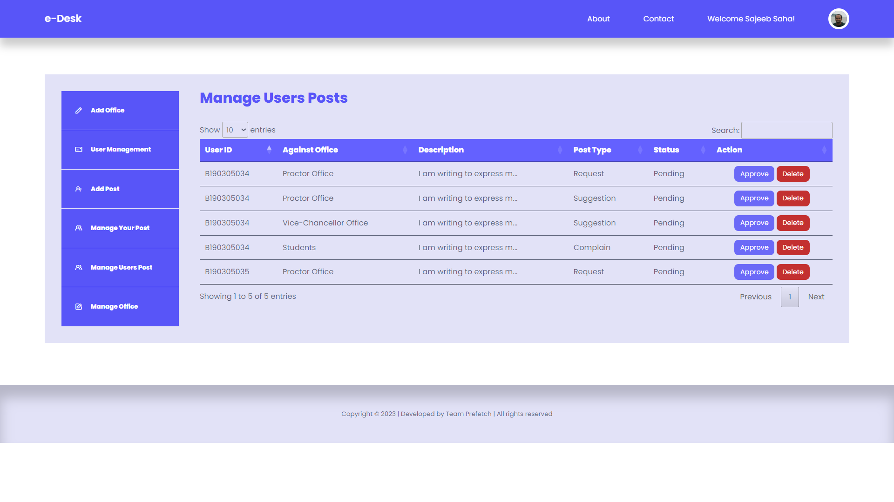
Super Admin – Dashboard

Slide 13
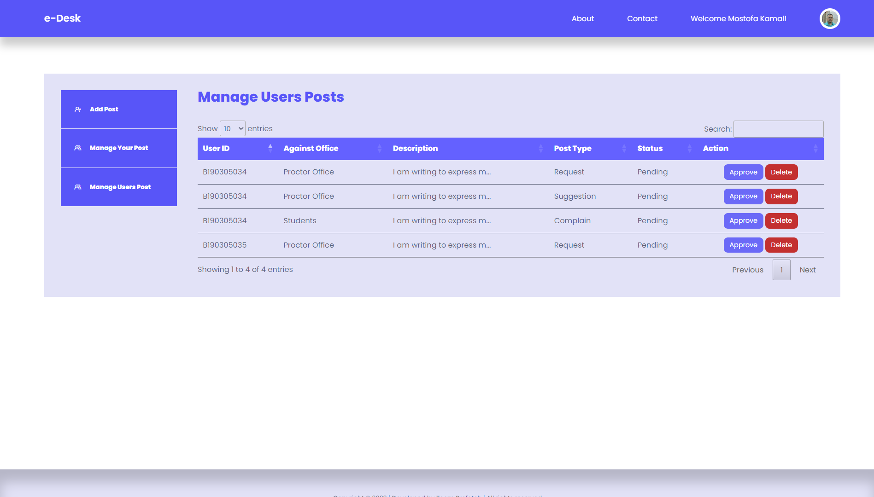
Categorized Admin – Dashboard

Slide 14
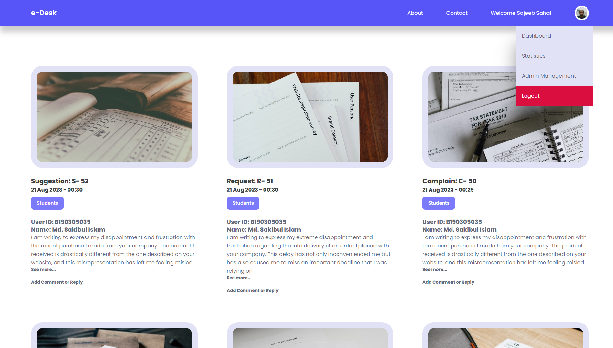
Super Admin – Home Page

Slide 15
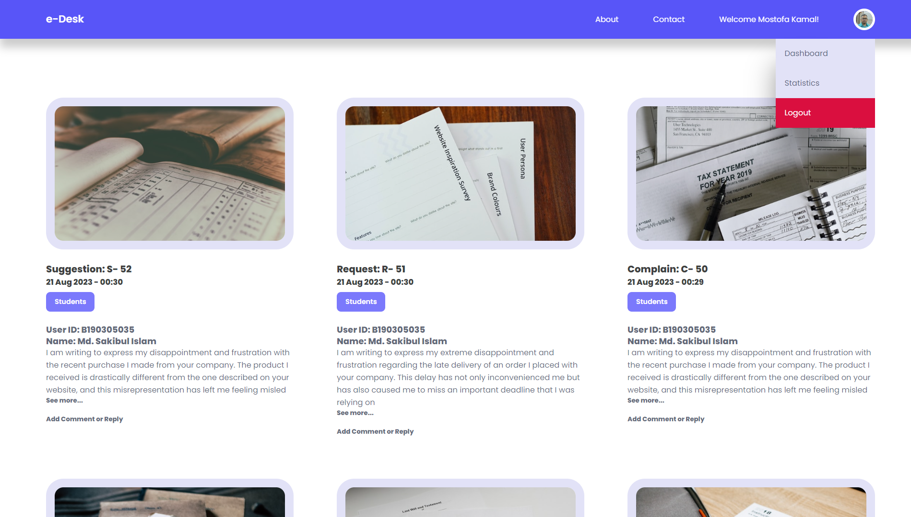
Categorized Admin – Home Page

Slide 16
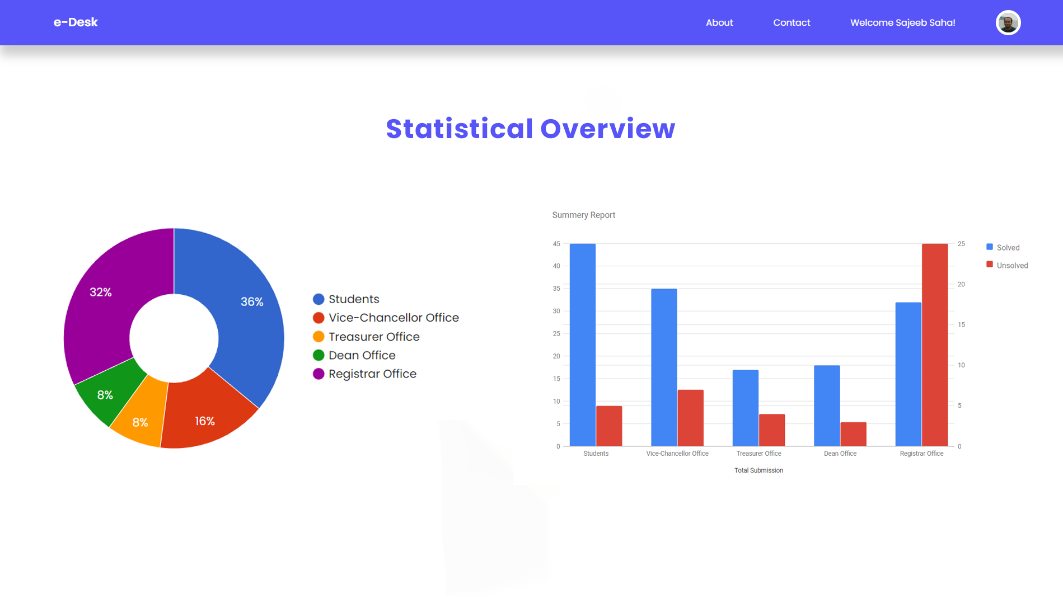
Statistical Overview

Slide 17
Tools and Technologies
Front-End
Back-End
HTML, CSS, JavaScript
PHP
Database
Tools
MySQL, Azure Cloud
Visual Studio Code, XAMPP, Azure Data Studio

Slide 18
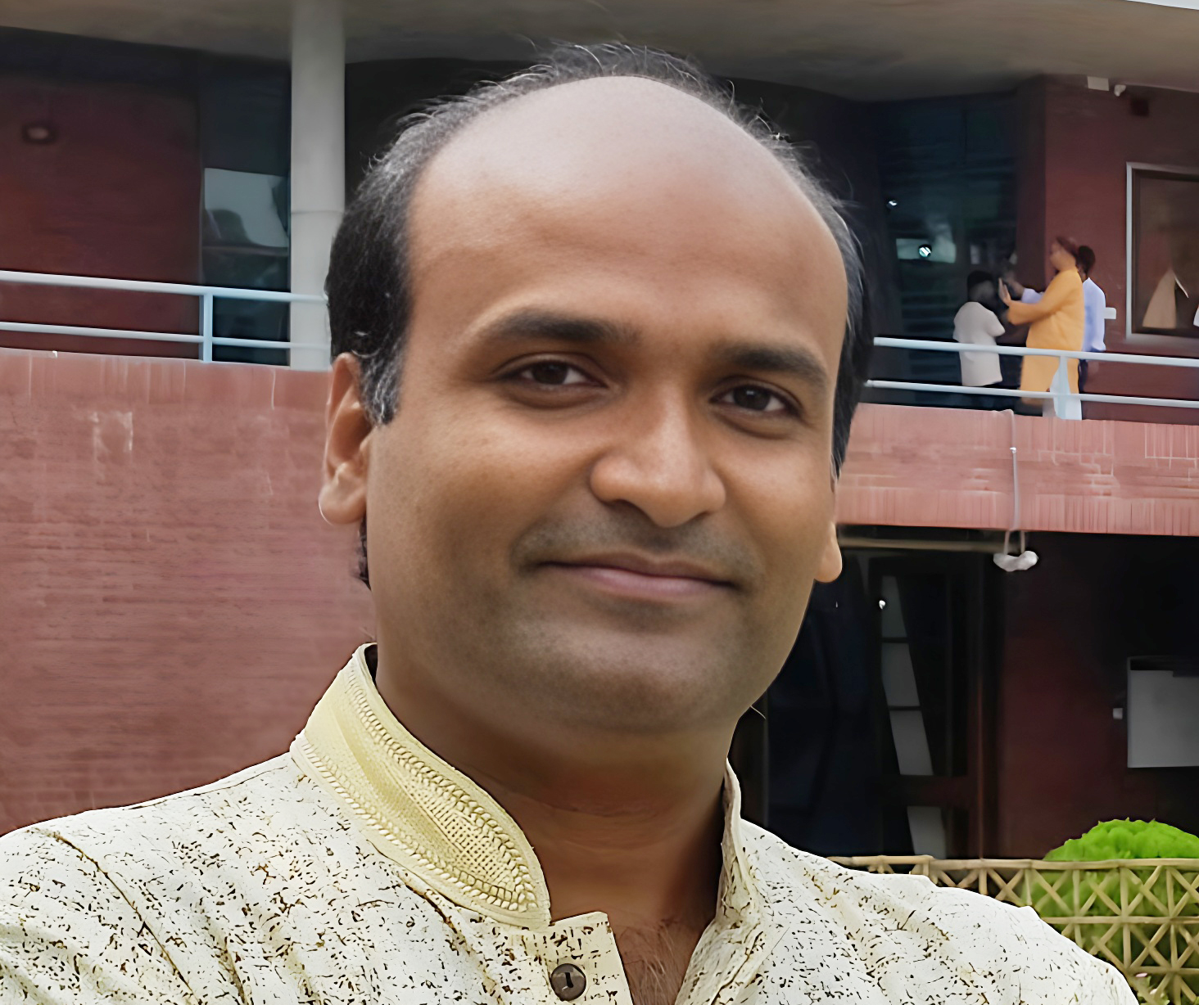

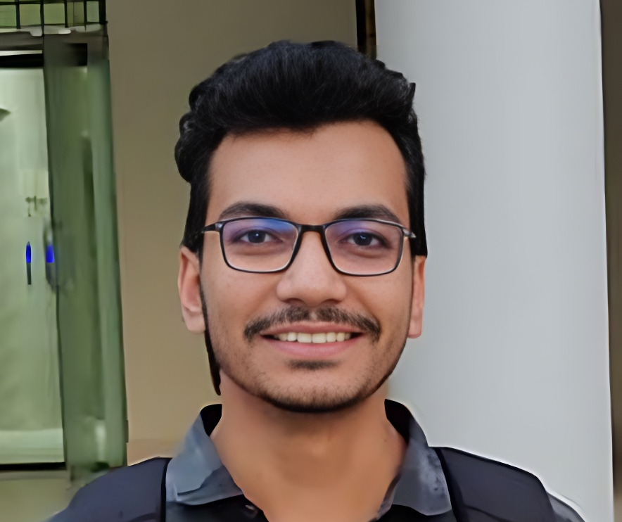
Internet and Web Programming (Project) Course Code: CSE-3109
Dr. Sajeeb Saha
Course Instructor
Associate Professor,
Dept. of CSE, JnU
Nishat Mahmud
Md. Waliul Islam Rayhan
B190305003
B190305034

Slide 19


Thank You
Share your feedback: teamprefetch@gmail.com
http://edesk.epizy.com

